Slide 1
Foundations of Machine Learning
Module 4:
Part C: Naïve Bayes
Sudeshna Sarkar
IIT Kharagpur

Slide 2
Bayes Theorem

Slide 3
Naïve Bayes
Bayes classification
Difficulty: learning the joint probability
Naïve Bayes classification
Assume all input features are conditionally independent!
Notes:
For a class, the previous generative model can be decomposed by n generative models of a single input.

Slide 4
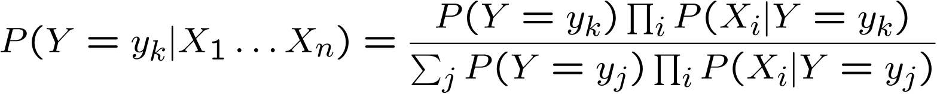
Naïve Bayes
Bayes rule:
Assuming conditional independence among X_{i}’s:
So, classification rule for X^{new} = < X₁, …, X_{n} > is:

Slide 5

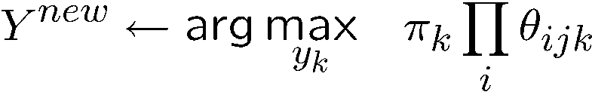
Naïve Bayes Algorithm – discrete X_{i}
Train Naïve Bayes (examples)
for each* value y_{k}
estimate
for each* value x_{ij} of each attribute X_{i}
estimate
Classify (X^{new})
* probabilities must sum to 1, so need estimate only n-1 parameters...

Slide 6
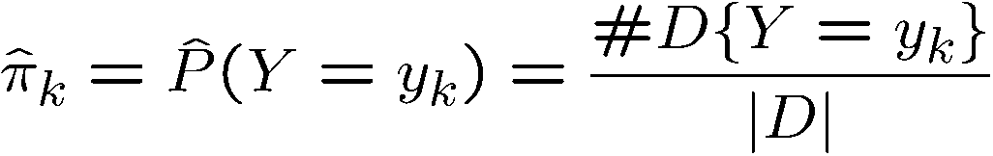
Estimating Parameters: Y, X_{i} discrete-valued
Maximum likelihood estimates (MLE’s):
Number of items in set D for which Y=y_{k}

Slide 7
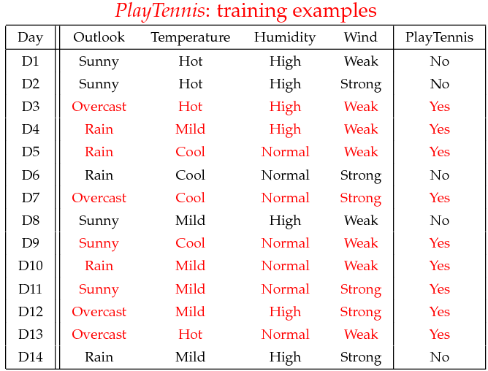
Example
Example: Play Tennis

Slide 8
Example
Learning Phase
Outlook | Play=Yes | Play=No
Sunny | 2/9 | 3/5
Overcast | 4/9 | 0/5
Rain | 3/9 | 2/5
Temperature | Play=Yes | Play=No
Hot | 2/9 | 2/5
Mild | 4/9 | 2/5
Cool | 3/9 | 1/5
Humidity | Play=Yes | Play=No
High | 3/9 | 4/5
Normal | 6/9 | 1/5
Wind | Play=Yes | Play=No
Strong | 3/9 | 3/5
Weak | 6/9 | 2/5
P(Play=Yes) = 9/14
P(Play=No) = 5/14

Slide 9
Example
Test Phase
Given a new instance, predict its label
x’=(Outlook=Sunny, Temperature=Cool, Humidity=High, Wind=Strong)
Look up tables achieved in the learning phrase
Decision making with the MAP rule
P(Outlook=Sunny|Play=Yes) = 2/9
P(Temperature=Cool|Play=Yes) = 3/9
P(Huminity=High|Play=Yes) = 3/9
P(Wind=Strong|Play=Yes) = 3/9
P(Play=Yes) = 9/14
P(Outlook=Sunny|Play=No) = 3/5
P(Temperature=Cool|Play==No) = 1/5
P(Huminity=High|Play=No) = 4/5
P(Wind=Strong|Play=No) = 3/5
P(Play=No) = 5/14
P(Yes|x’) ≈ [P(Sunny|Yes)P(Cool|Yes)P(High|Yes)P(Strong|Yes)]P(Play=Yes) = 0.0053
P(No|x’) ≈ [P(Sunny|No) P(Cool|No)P(High|No)P(Strong|No)]P(Play=No) = 0.0206
Given the fact P(Yes|x’) < P(No|x’), we label x’ to be “No”.

Slide 10
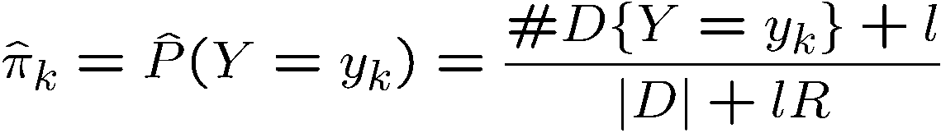
Estimating Parameters: Y, X_{i} discrete-valued
If unlucky, our MLE estimate for P(X_{i} | Y) may be zero.
MAP estimates:
Only difference: “imaginary” examples

Slide 11
Naïve Bayes: Assumptions of Conditional Independence
Often the X_{i} are not really conditionally independent
We can use Naïve Bayes in many cases anyway
often the right classification, even when not the right probability

Slide 12
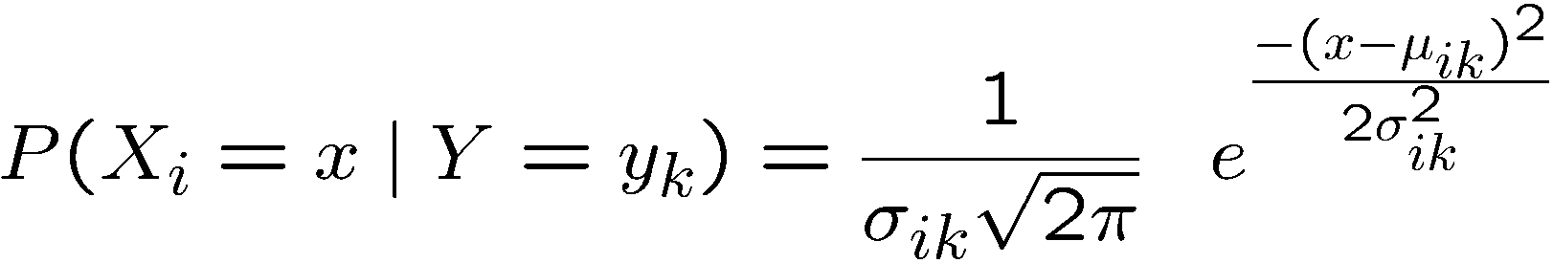
Gaussian Naïve Bayes (continuous X)
Algorithm: Continuous-valued Features
Conditional probability often modeled with the normal distribution
Sometimes assume variance
is independent of Y (i.e., σ_{i}),
or independent of X_{i} (i.e., σ_{k})
or both (i.e., σ)

Slide 13


Gaussian Naïve Bayes Algorithm – continuous X_{i} (but still discrete Y)
Train Naïve Bayes (examples)
for each value y_{k}
estimate*
for each attribute X_{i} estimate
class conditional mean , variance
Classify (X^{new})

Slide 14
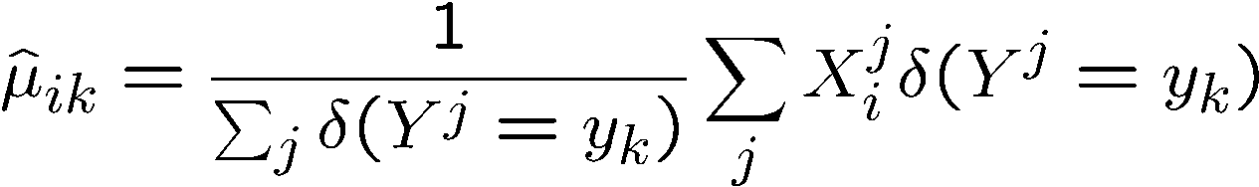
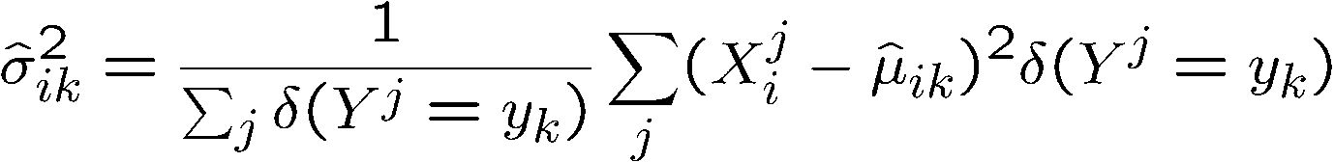
Estimating Parameters: Y discrete, X_{i} continuous
Maximum likelihood estimates:
jth training example
ith feature
kth class
δ(z)=1 if z true, else 0

Slide 15
Naïve Bayes
Example: Continuous-valued Features
Temperature is naturally of continuous value.
Yes: 25.2, 19.3, 18.5, 21.7, 20.1, 24.3, 22.8, 23.1, 19.8
No: 27.3, 30.1, 17.4, 29.5, 15.1
Estimate mean and variance for each class
Learning Phase: output two Gaussian models for P(temp|C)

Slide 16
The independence hypothesis…
makes computation possible
yields optimal classifiers when satisfied
Rarely satisfied in practice, as attributes (variables) are often correlated.
To overcome this limitation:
Bayesian networks combine Bayesian reasoning with causal relationships between attributes

Slide 17
Thank You

